Slide 1


Education through collaborating on real world problems
https://omdena.com/chapters/

Slide 2

Solving community problems using Artificial Intelligence
https://omdena.com/omdena-chapter-page-nigeria/

Slide 3
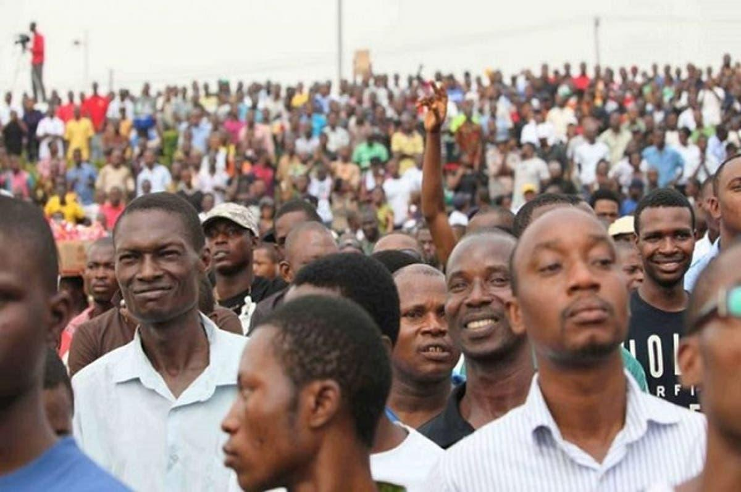
The Project
Solving Unemployment in Nigeria using Artificial Intelligence

Slide 4
Problem Statement
The Unemployment rate in Nigeria increased to 33.30 percent in the fourth quarter of 2020 from 27.10 percent in the second quarter of 2020 while the underemployed rate is 28.7% giving a total percentage rate of 61.9% of Nigerians that are unemployed or underemployed

Slide 5
Project Goals
To create a machine learning model that will merge NYSC graduates with possible job opportunities based on their career path
To provide employable job skills recommendation to NYSC graduates based on their their career path

Slide 6
Week 1 (kick-off): Task done
Assigned Task Leaders
Identified platforms for data extractions
Identified technical skills needed
General understanding of the problem
Relevant links to articles and dataset

Slide 7
Week 2: Data gathering
Relevant Jobs dataset
Data visualisation
Data Gathering & Extraction
Data cleaning
Feature Engineering
Candidate Dataset
Demographic (Age, Gender, State, Address)
courses
Education level
Disabilities
Skills
Location

Slide 8

Week 2: Workshop training
Web scraping
Data wrangling

Slide 9

keep in touch on slack

